Slide 1
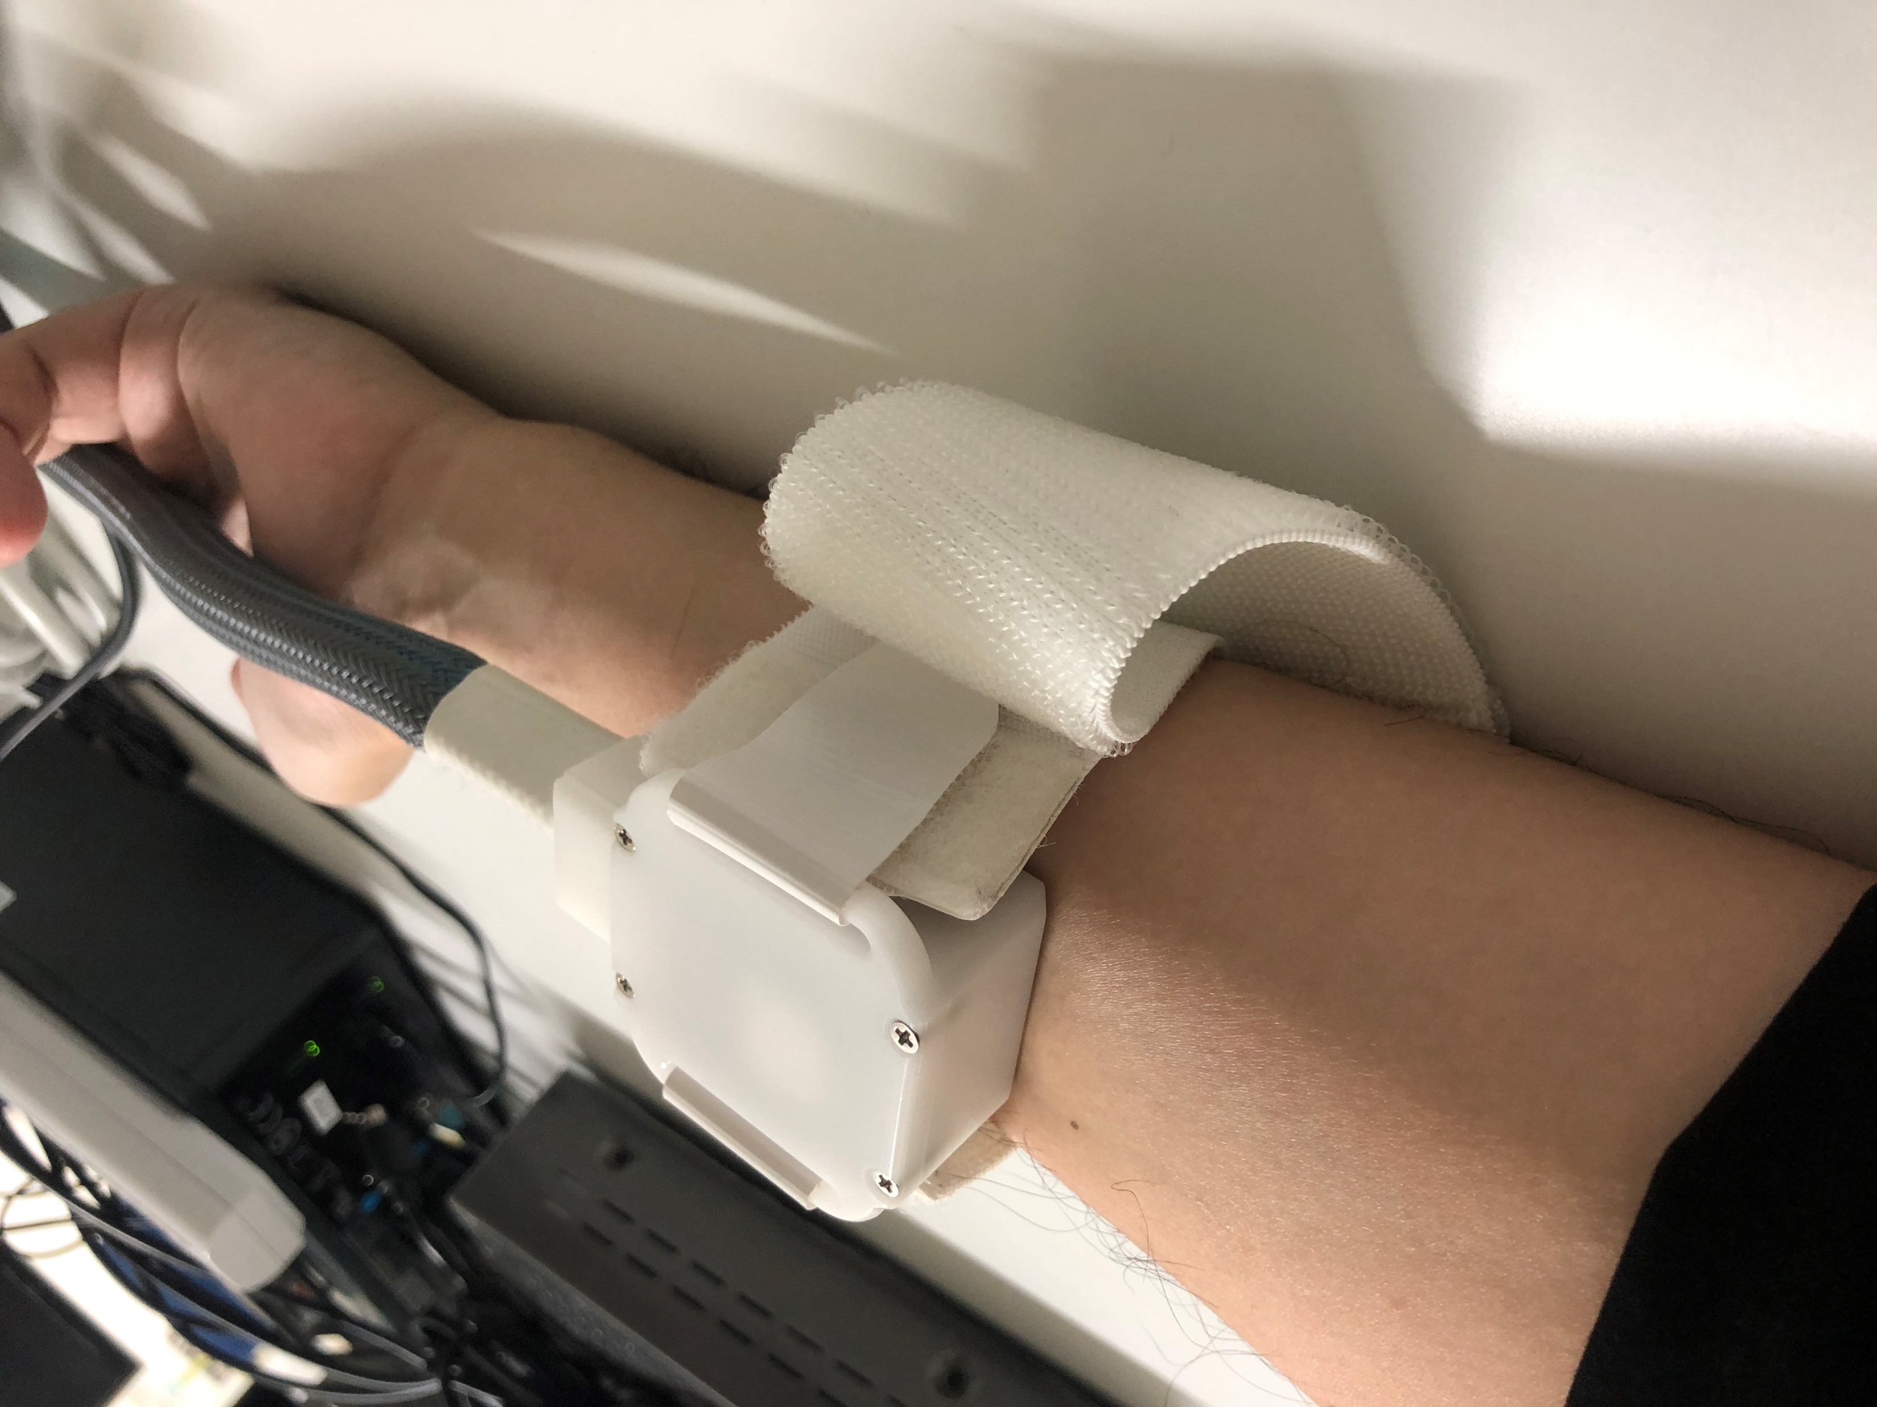

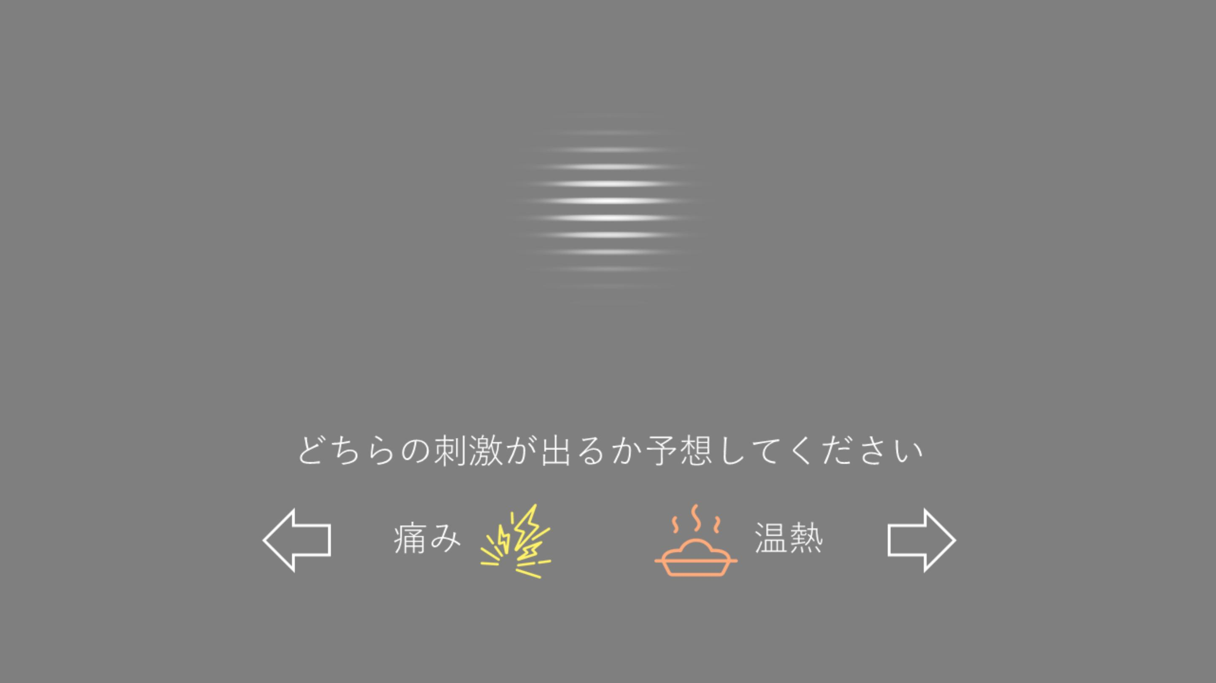
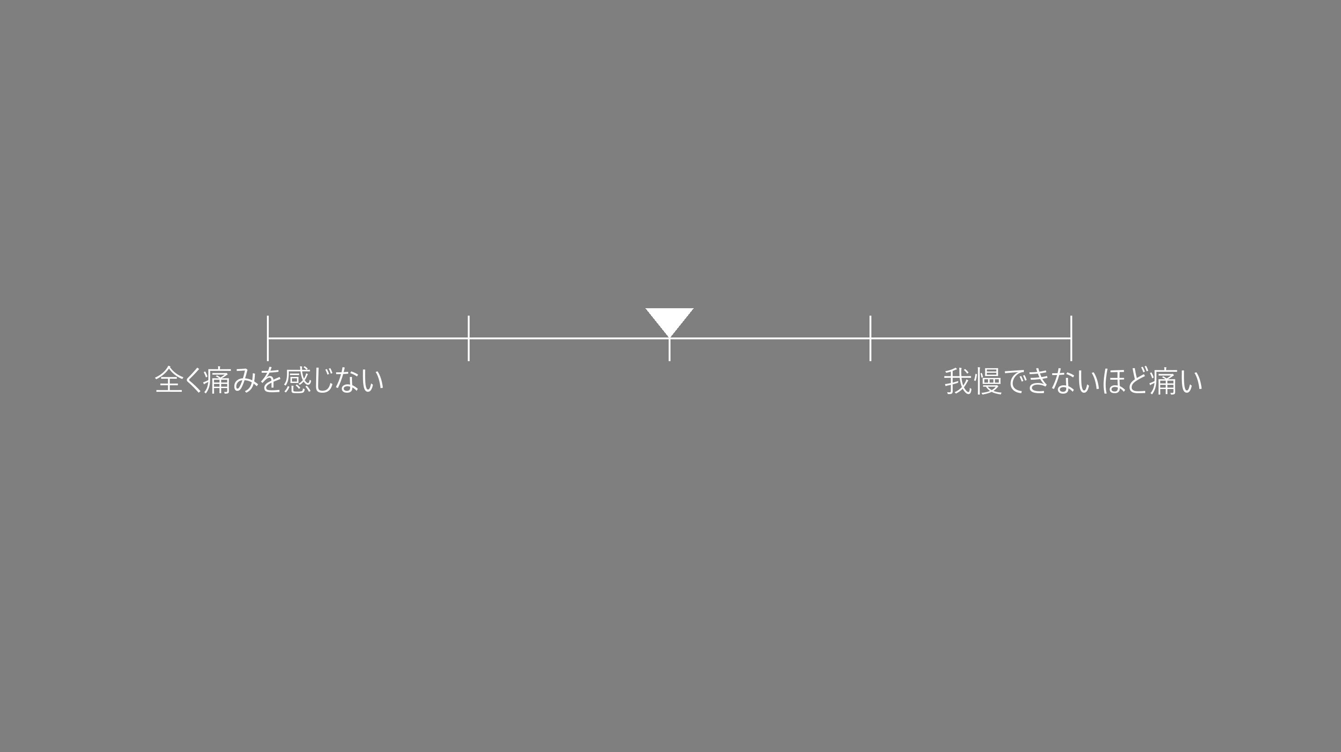
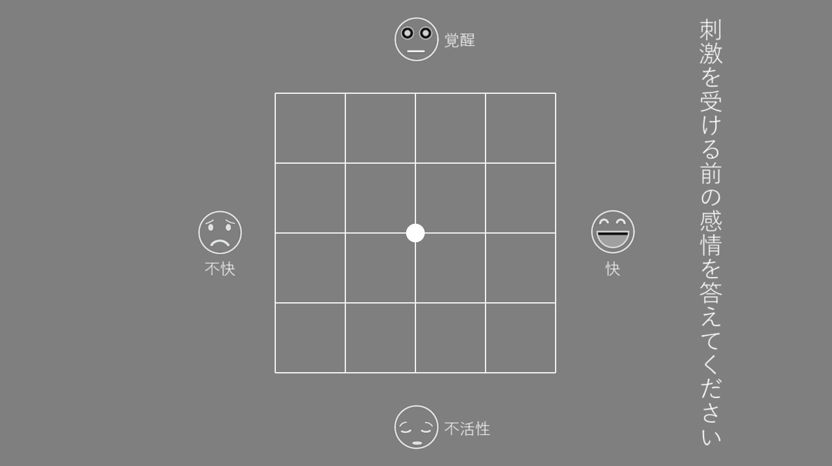
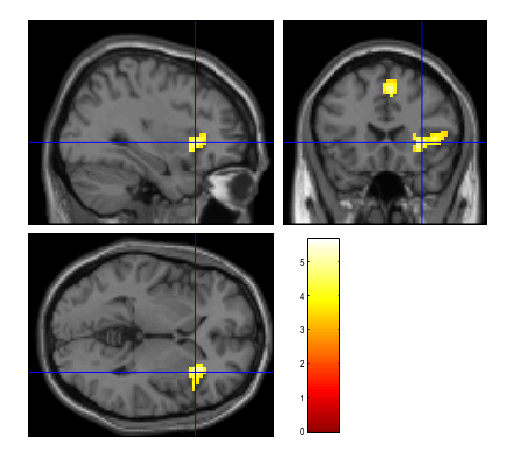
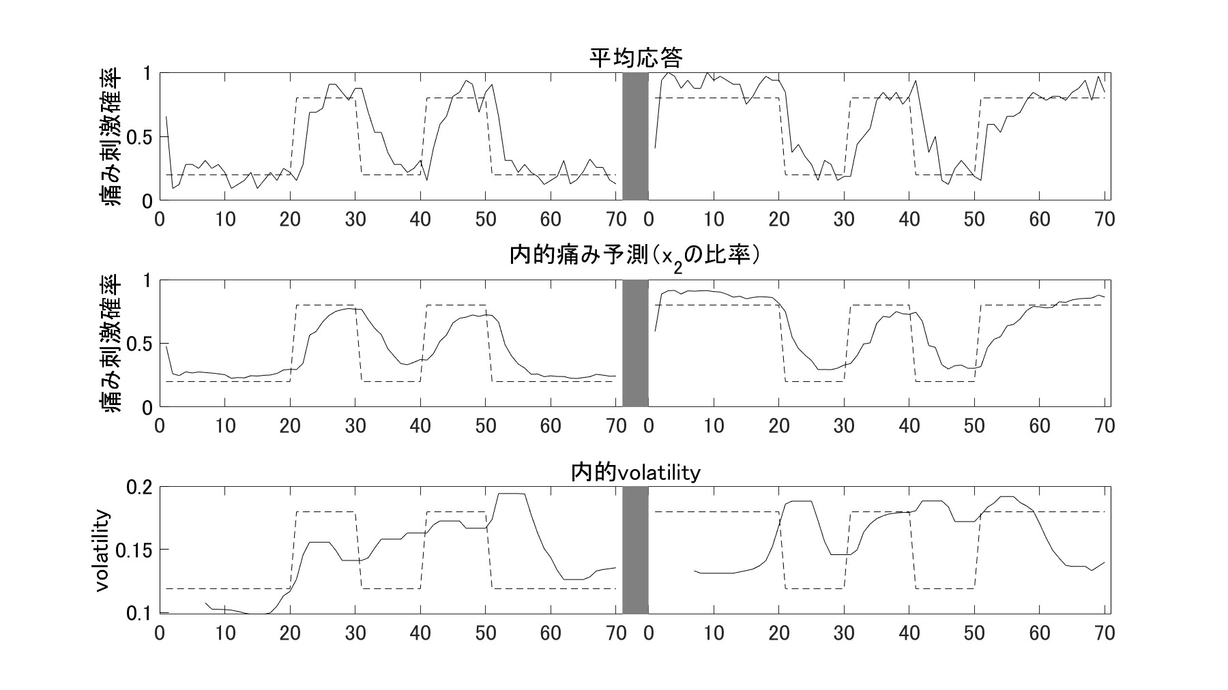

80% 痛み
20% 温熱
Cue A
20% 痛み
80% 温熱
Cue B
$$volatility≜x_{2}\left(1−x_{2}\right)∙exp\left(x_{3}\right)$$
SMC
0.5s
3.0s
~1.0s
3.0s
5.0s
~2.5s
~3.5s
固視点
Cue
痛み予測
予期
痛み刺激
痛み評定
感情評定
aIns
uncorr. p < 0.001 at peak level
FWE p < 0.05 at cluster level

Slide 3
Purpose

Slide 4
Expected results
Volatility of monetary reward -> ACC (Behrens et al., 2007; Silvetti et al., 2013)
Volatility of pain -> insula
Volatility relates emotion. (Mathys et al., 2011)
Volatility affects emotion ratings.
Volatility affects BIN measures.
HRV, HEP, EGG
ASD showed unusual behavior to changes in volatility. (Lawson et al., 2017)
Individual differences in personality affect behavior to change in volatility.
BDI, MAIA, BPQ, BRS, RS14, JPSS

Slide 5
Methods

Slide 6
1 trial
Conditions
Cue
A (Gabor 0°)
B (Gabor 90°)
Heat stimuli
Pain（48℃）
Warm（35℃）
Cue-stim probability
A⇒P:80%, W:20% B⇒P:20%, W:80%
A⇒P:20%, W:80% B⇒P:80%, W:20%
Volatility
Volatile: probabilities switched every 10 trials
Stable: same probability lasts for 20 trials
1.0s
0.5s
3.0s
~1.0s
3.0s
4.0s
~2.5s
~3.5s
fixation
Cue
2AFC
Antici-
pation
Stim
Pain
VAS
Affective
grid
1.0
1.5
4.5
5.5
8.5
12.5
15.0
18.5
11.5s + response(~7.0s) × 140 trials = 43’ 10”
Cue-stim conditioning
example）
A⇒P:1 time, W:4 times
B⇒P:4 times, W:1 time
①
②
①
②
①
Volatility
S
V
S

Slide 7
Trial
1.0s
0.5s
3.0s
~1.0s
3.0s
5.0s
~2.5s
~3.5s
Fixation
Cue
2AFC
Anticipation
Stimulus
Pain VAS
Affective grid
1.0
1.5
4.5
5.5
8.5
12.5
15.0
18.5
(11.5 s + 7.0 s（response）) ×140 trials = 43’ 10’’

Slide 8
Measured value
Physiological measures
fMRI
EEG (32ch)
EGG (electrogastrogram, 26ch)
ECG (6ch)
PPG (noisy)
BP (low sampling rate)
Respiration
Skin conductance
Pupil diameter (noisy)
Questionnaires
BDI
MAIA
BRS (Bidimentional Resilience Scale)
RS14
BPQ
JPSS
Task
Pain prediction (2AFC)
Pain VAS
Pain AG

Slide 9
Results

Slide 10
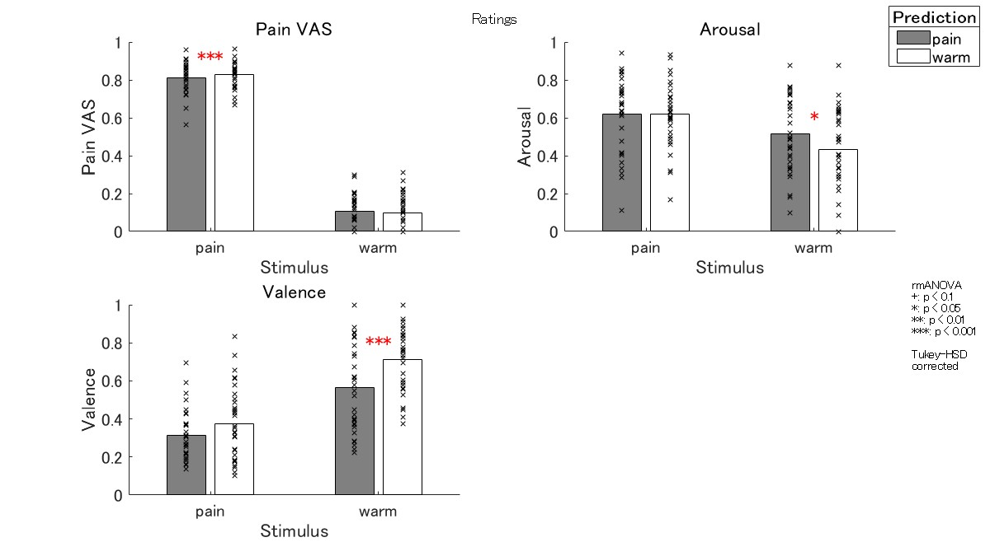
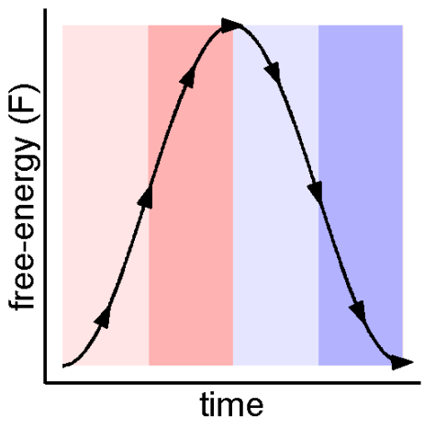
Ratings
Pain VAS: prediction error effect
Arousal: prediction error effect
Valence: free-energy decreasing effect
Notes:
In the VAS, participants felt more pain when they were in pain when they expected the warm. This is thought to be due to the effect of prediction error.
In valence, the response became more positive when participants predicted the warm and received the warm.
This is consistent with the free energy and emotion models introduced at the beginning.
If you have a positive expectation and a positive result that matches it, the free-energy will decrease and you will feel happy.

Slide 11




Volatility model
x₃
ω₃
$$x_{3}^{(t)}\sim N\left(x_{3}^{(t−1)},exp\left(ω_{3}\right)\right)$$
Volatility
$$x_{2}^{(t)}\sim N\left(x_{2}^{(t−1)},exp\left(x_{3}^{(t)}+ω_{2}\right)\right)$$
Probability of pain
x₂
ω₂
$$x_{1}^{(t)}\sim Bernoulli\left(s\left(x_{2}^{(t)}\right)\right)$$
Response
x₁
$$s(x)≜\frac{1}{1+exp⁡(−x)}$$
Ref. Lawson et al., 2017

Slide 12
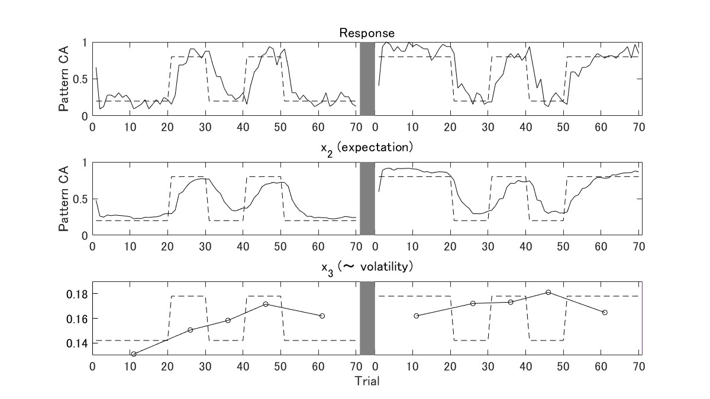
Volatility model

Slide 13
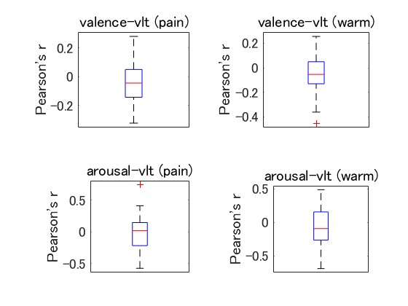
Emotion and volatility
No significant correlation found between emotion ratings and volatility

Slide 14
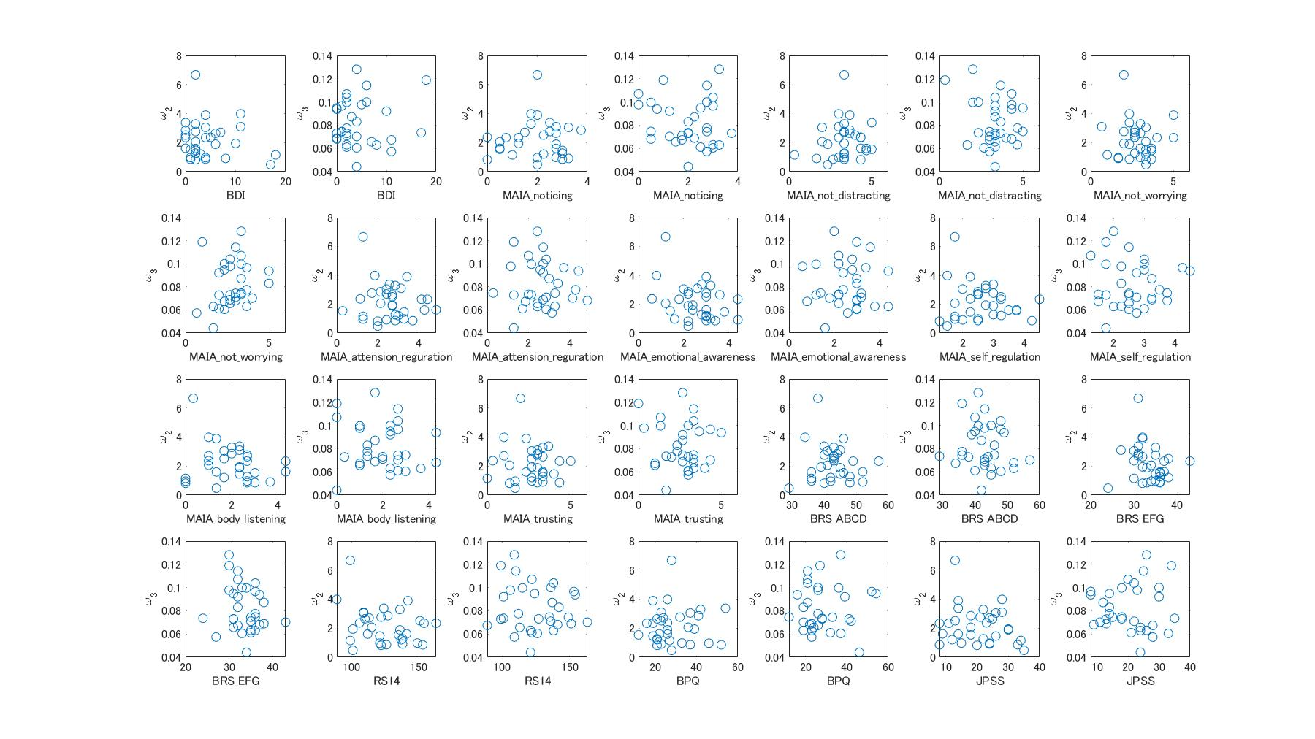
Individual difference
No significant relationship found between volatility parameters and questionnaires

Slide 15

fMRI
1.0s
0.5s
3.0s
~1.0s
3.0s
4.0s
~2.5s
~3.5s
$$volatility≜x_{2}\left(1−x_{2}\right)∙exp\left(x_{3}\right)$$
fixation
Cue
2AFC
Antici-
pation
Stim
Pain
VAS
Affective
grid
1.0
1.5
4.5
5.5
8.5
12.5
15.0
18.5
SMC
aIns
There was a correlation between volatility and anterior insula activity
uncorr. p < 0.001 at peak level
FWE p < 0.05 at cluster level

Slide 16
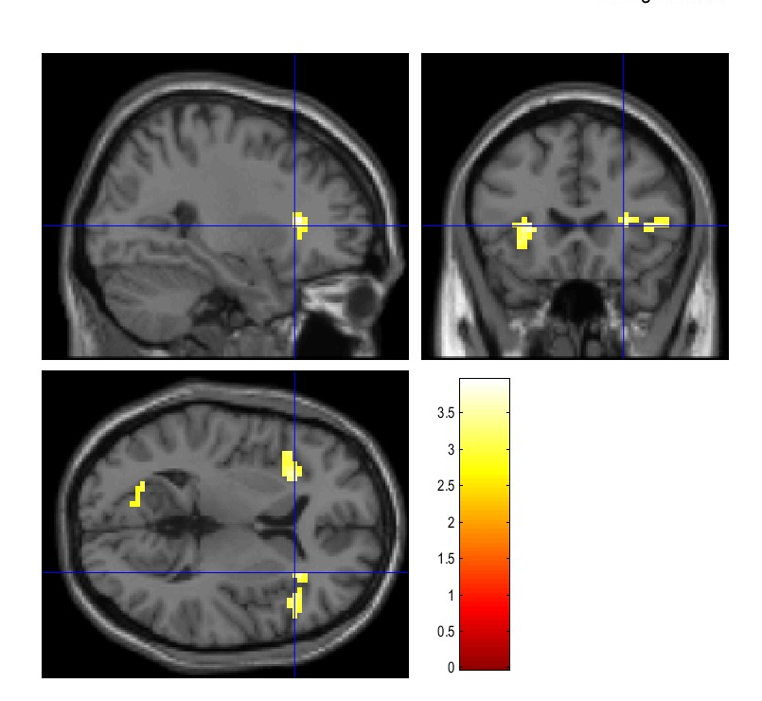
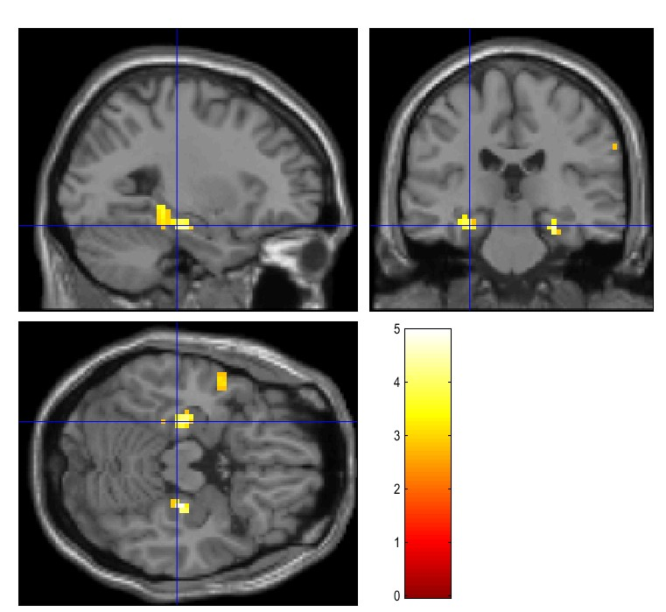
fMRI
1.0s
0.5s
3.0s
~1.0s
3.0s
4.0s
~2.5s
~3.5s
$$volatility≜x_{2}\left(1−x_{2}\right)∙exp\left(x_{3}\right)$$
fixation
Cue
2AFC
Antici-
pation
Stim
Pain
VAS
Affective
grid
1.0
1.5
4.5
5.5
8.5
12.5
15.0
18.5
Positive correlation
Negative correlation
Anterior insula
Parahippocampal
Stable -> memory
Volatile -> Intuitive, Emotional
uncorr. p < 0.005
at peak level
Notes:
In Stable condition, the memory process is working, and in Volatile condition, the intuitive or emotional process is working.
I can't conclude this way because the statistical power is so weak.

Slide 17
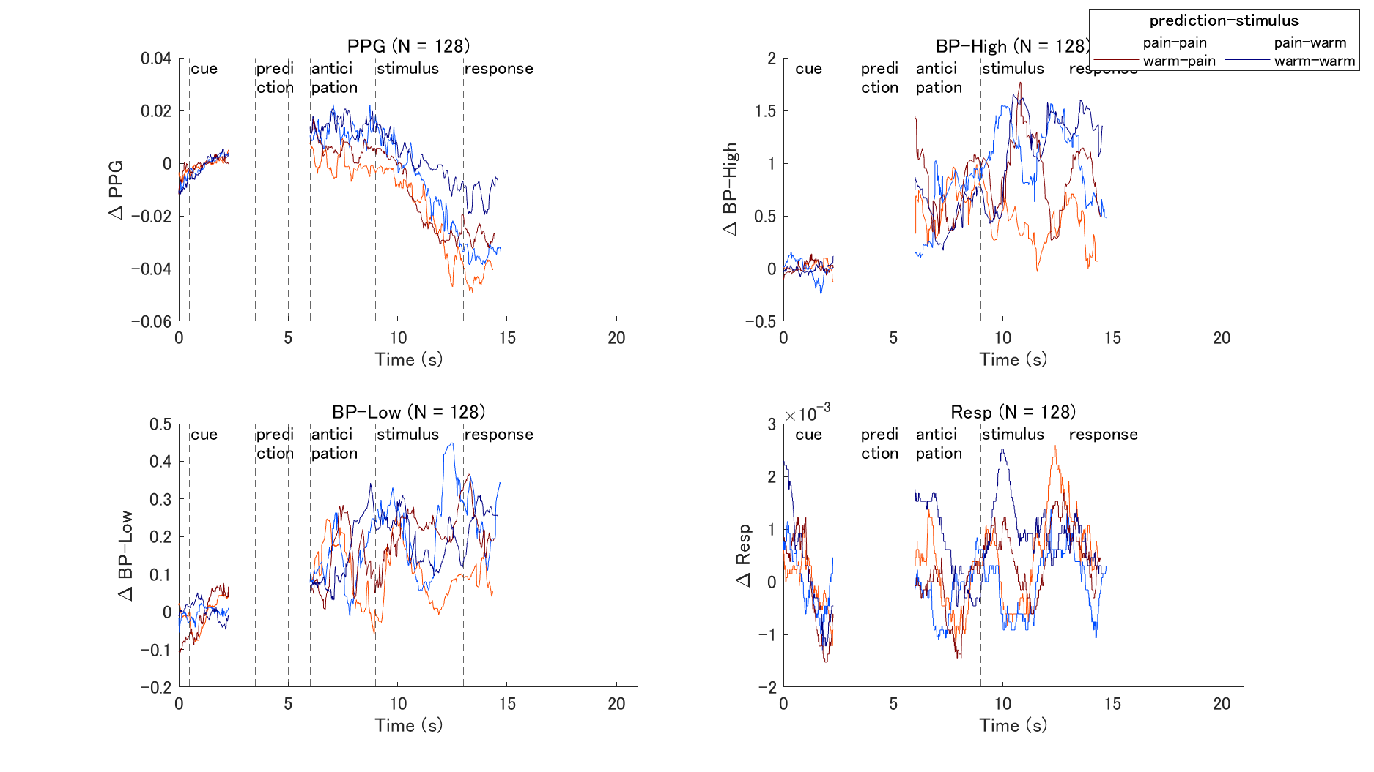

Slide 18
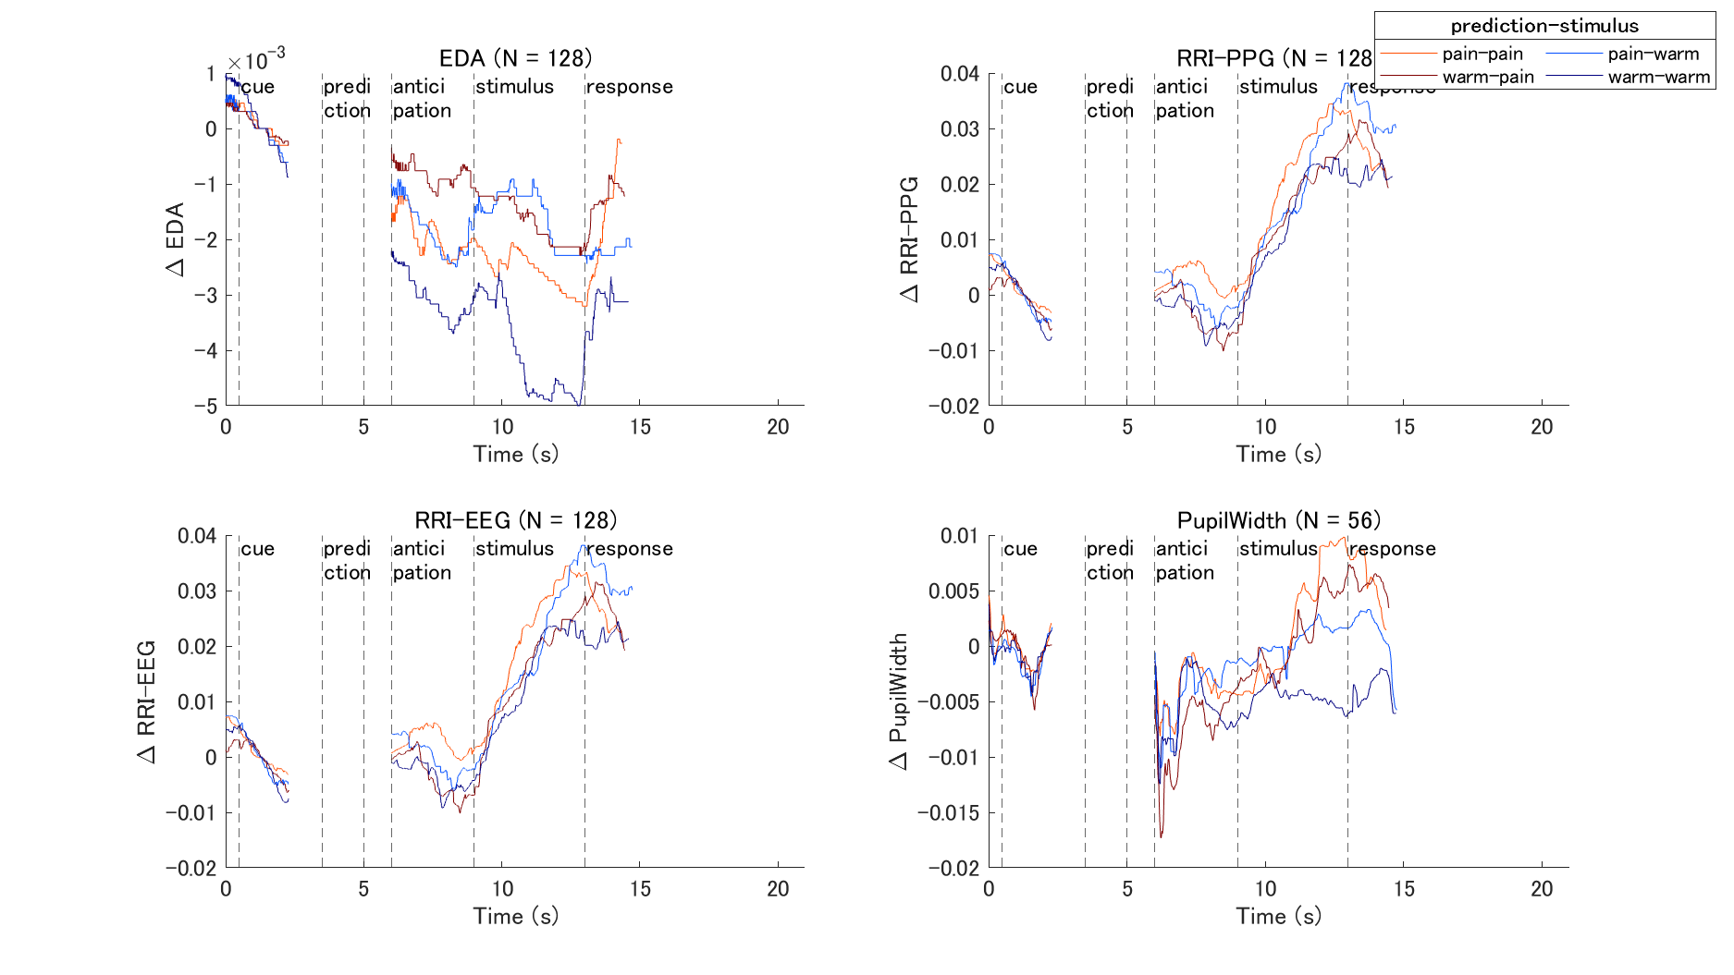

Slide 19
Summary
Volatility of pain -> insula
There was a correlation between volatility and anterior insula activity.
Volatility (free-energy) affects emotion ratings.
Valence increased when prediction was matched (decrease in free-energy).
No significant correlation found between volatility and ratings.
Volatility affects BIN measures
No significant relationship found.
Future works: HRV, HEP, EGG, EEG-fMRI
Individual differences in interoception or personality affect behavior to change in volatility
No significant relationship found.
Future works: Better behavioral model

